Slide 1





Office: Hyderabad, Visakhapatnam.

Slide 2
Continuous performance monitoring using LMS.
Test and Home work.
https://p.hck.re/bRQX
Coding practice links using Hacker rank based on topic wise.
Ex: www.hackerrank.com/walys-conditions1
Competitive coding using Hacker rank, Leet code and work@tech

Slide 3







Campus Recruitment Training (CRT)…
We provide Exam Portal to conduct Tests based on day wise topics.
Quantitative Aptitude Reasoning ability Verbal ability
Quantitative Aptitude
Interview
Training
Reasoning ability
Soft skills Communication skills
Competitive programming (for both product & service based)
Interview training (Technical + HR) Certification courses
Company oriented Training
Verbal ability
Technical Training

Slide 4














Mr. Satish Babu Kadali – MD

Slide 5




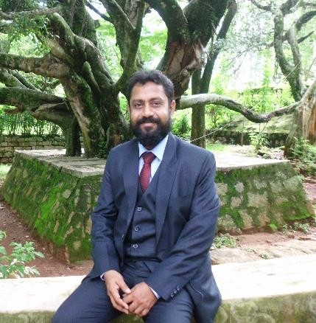


























Mr. Ram S – CEO

Slide 6
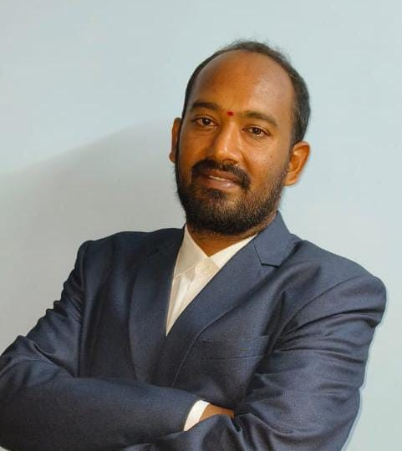
Mr. Balaji J – Co-ordinator
8 Years of experience to organize trainings and LMS platform

Slide 7
OUR ACHEIVEMENTS

Slide 8
2025

Slide 9


Slide 10
2026

Slide 11


Slide 12


Slide 13


Slide 14
OUR TRAINED COLLEGES

Slide 15

RAGHU ENGINEERING COLLEGE
VIZAG
CRT and Company specific

Slide 16

BAPATLA ENGINEERING COLLEGE
Bapatla
CRT

Slide 17

VIGNAN'S INSTITUTE OF MANAGEMENT AND TECHNOLOGY FOR WOMEN
Hyderabad
CRT Program

Slide 18

Mother Theresa Institute of Engineering and Technology
Palamaner
CRT Program

Slide 19

Hyderabad ACCENTURE Company Specific Training

Slide 20

Santhiram Engineering College Nandyal CRT and Company Specific program - Infosys

Slide 21

CHALAPATHI INSTITUTE OF ENGINEERING & TECHNOLOGY Guntur CRT program

Slide 22

RISE Krishna Sai Prakasam Group of Institutions Ongole Company Specific Program - Juspay

Slide 23

Vaageswari College of Engineering Karimnagar CRT program

Slide 24

IDEAL Institute of Technology Kakinada CRT program

Slide 25

International School of Technology and Sciences for Women Rajamahendravaram CRT program

Slide 26


KLR College of Engineering and Technology Palvancha CRT program

Slide 27
GALLERY

Slide 28
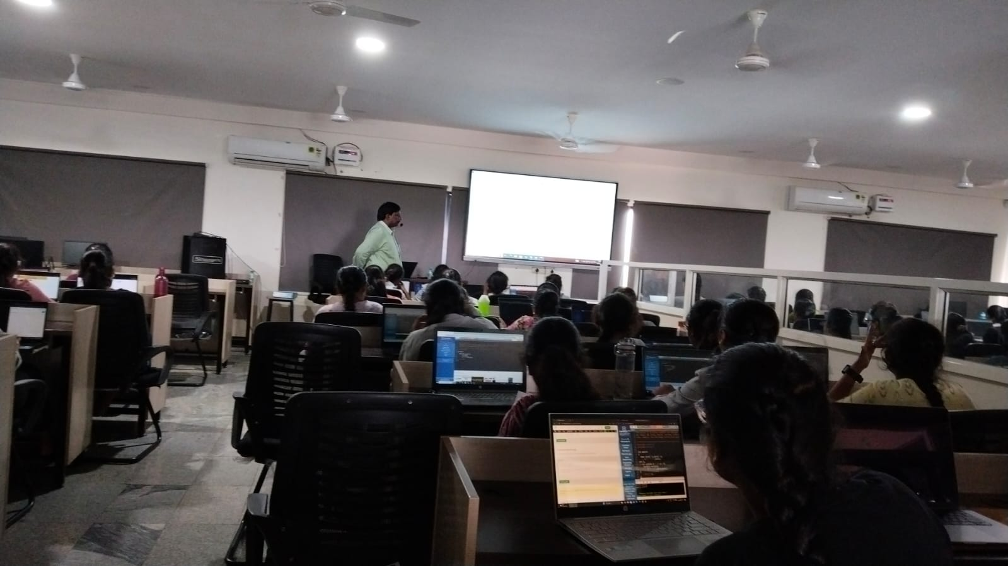

Slide 29
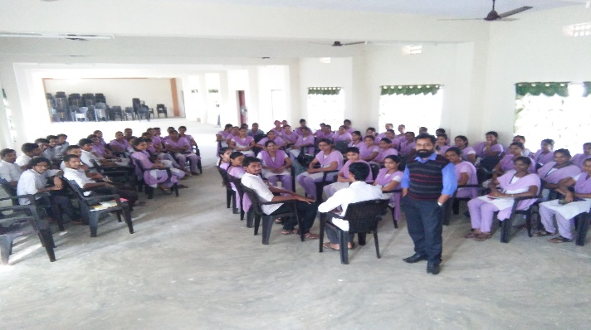

Slide 30
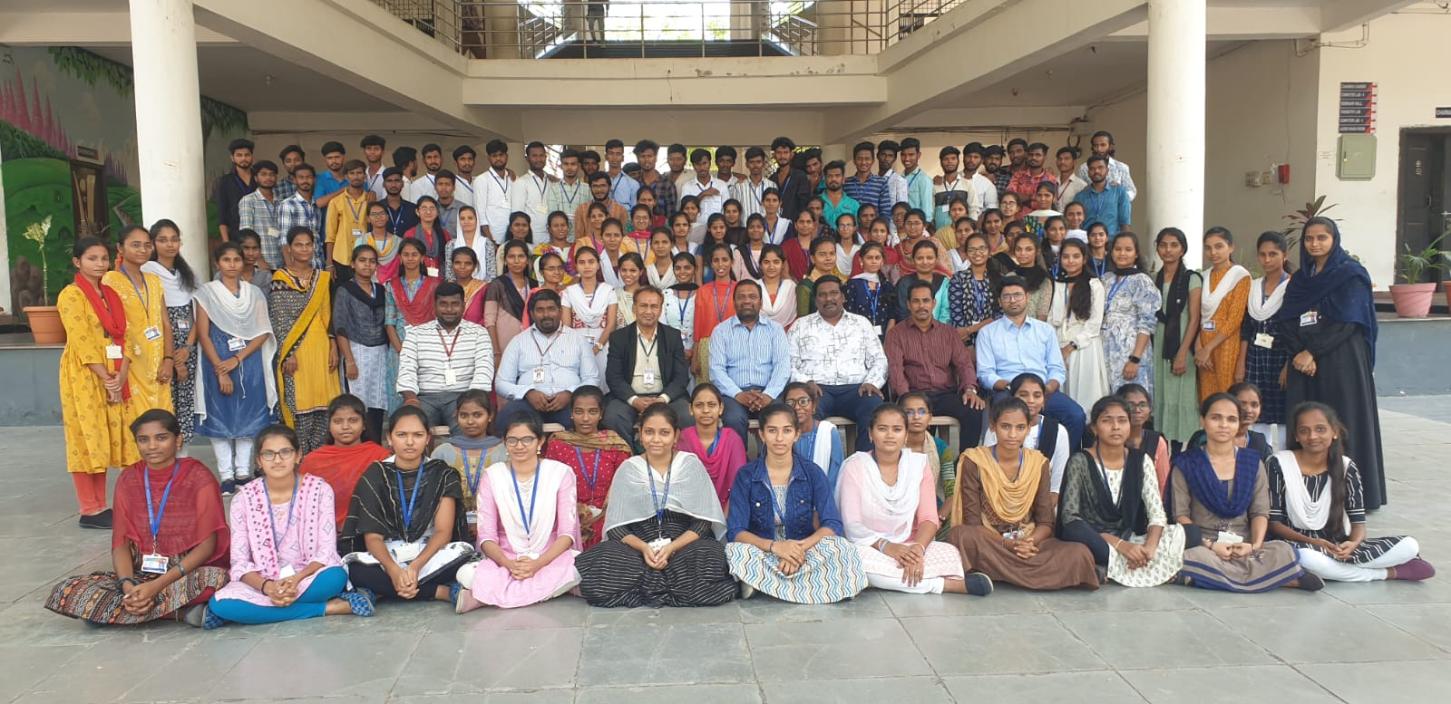

Slide 31
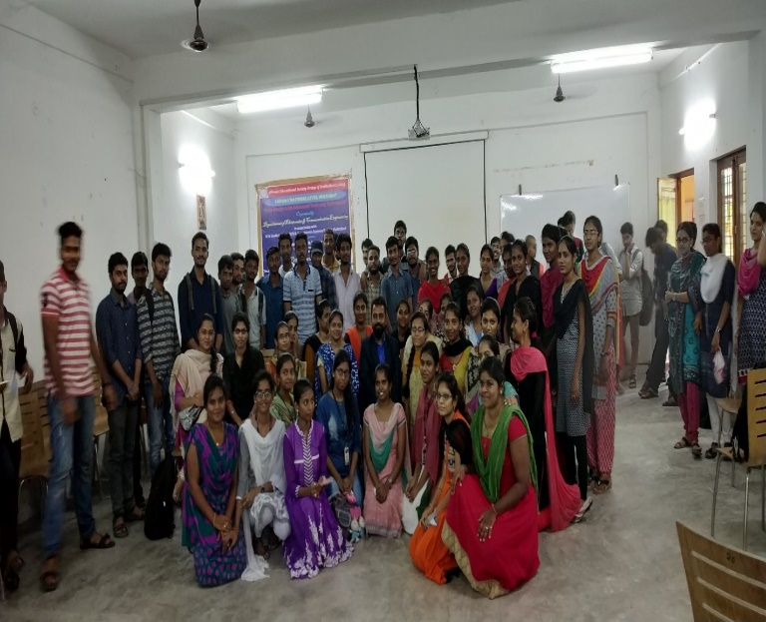

Slide 32
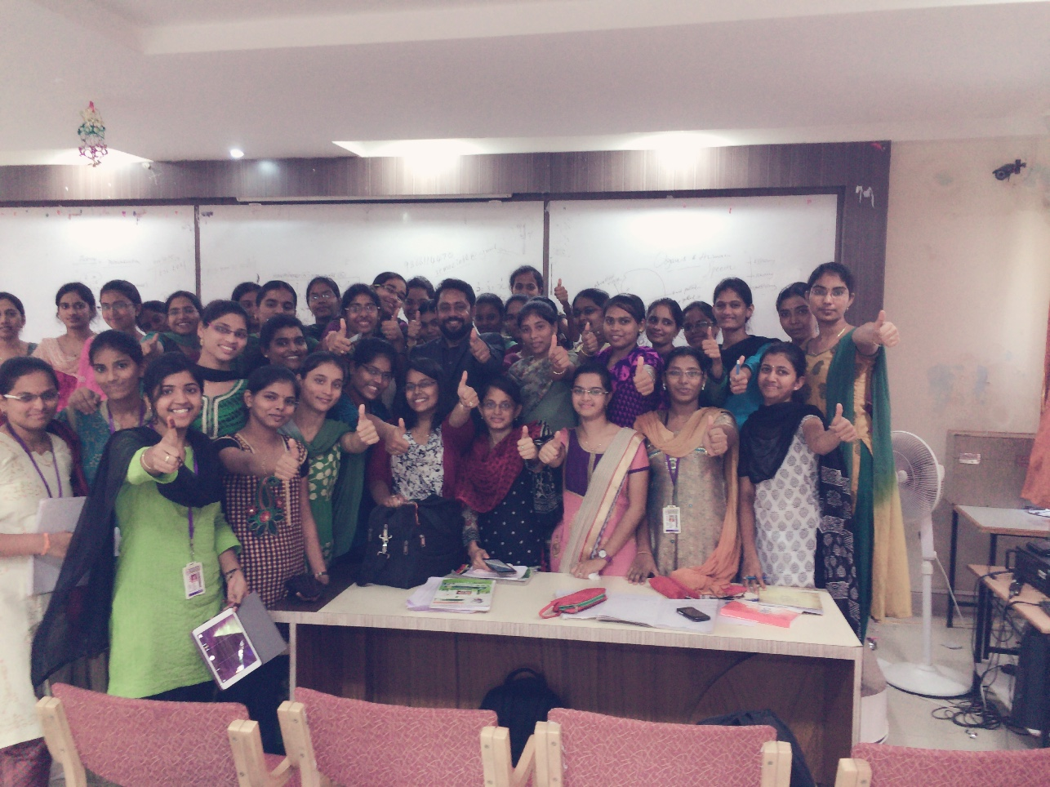

Slide 33
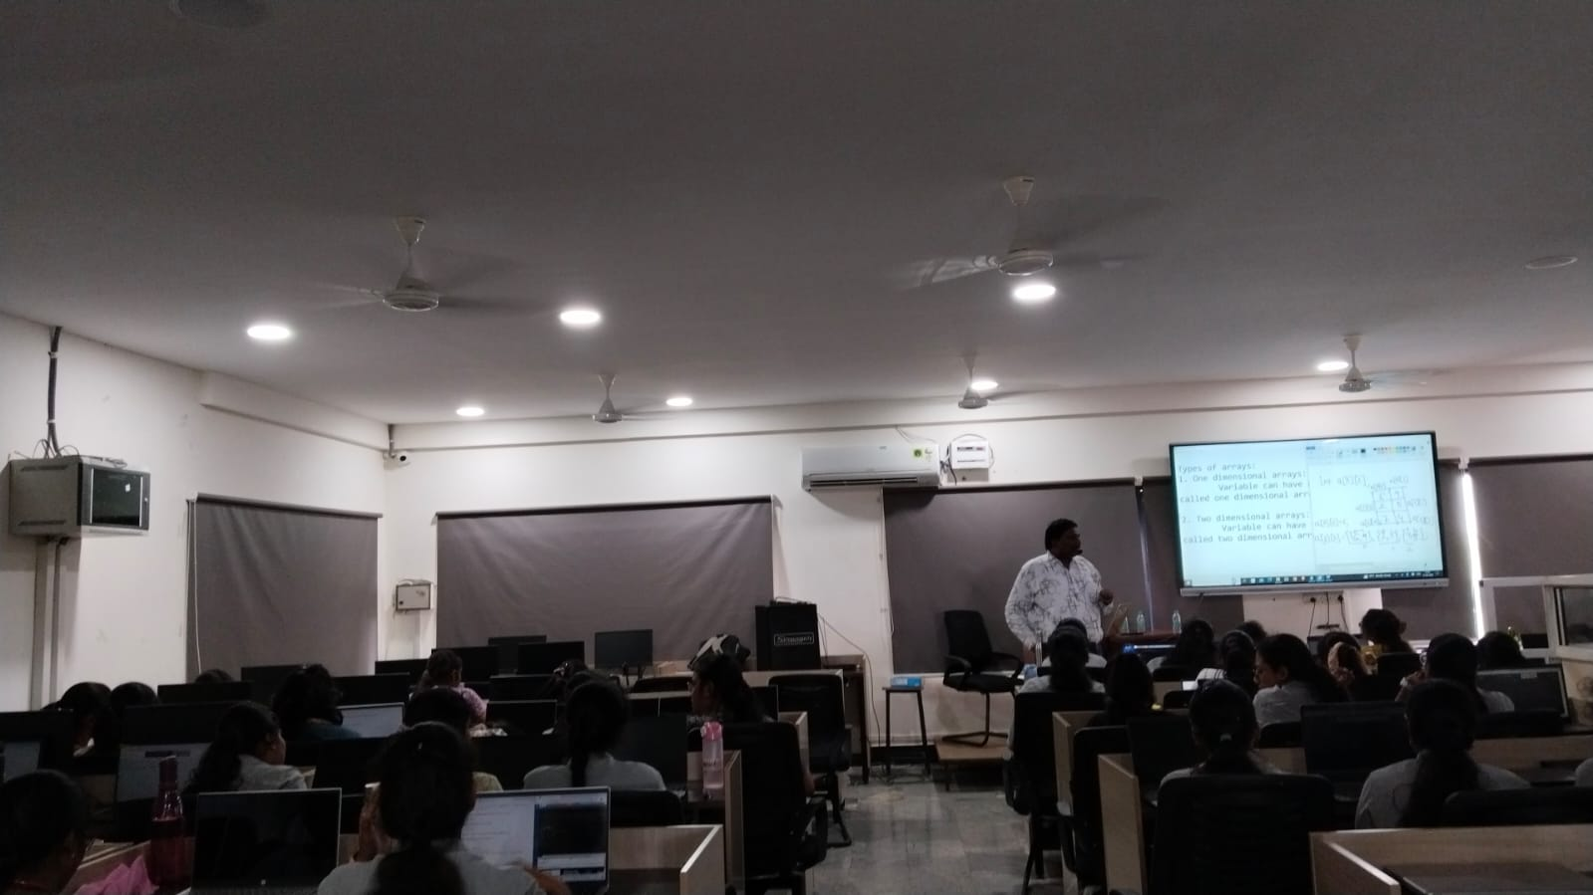

Slide 34
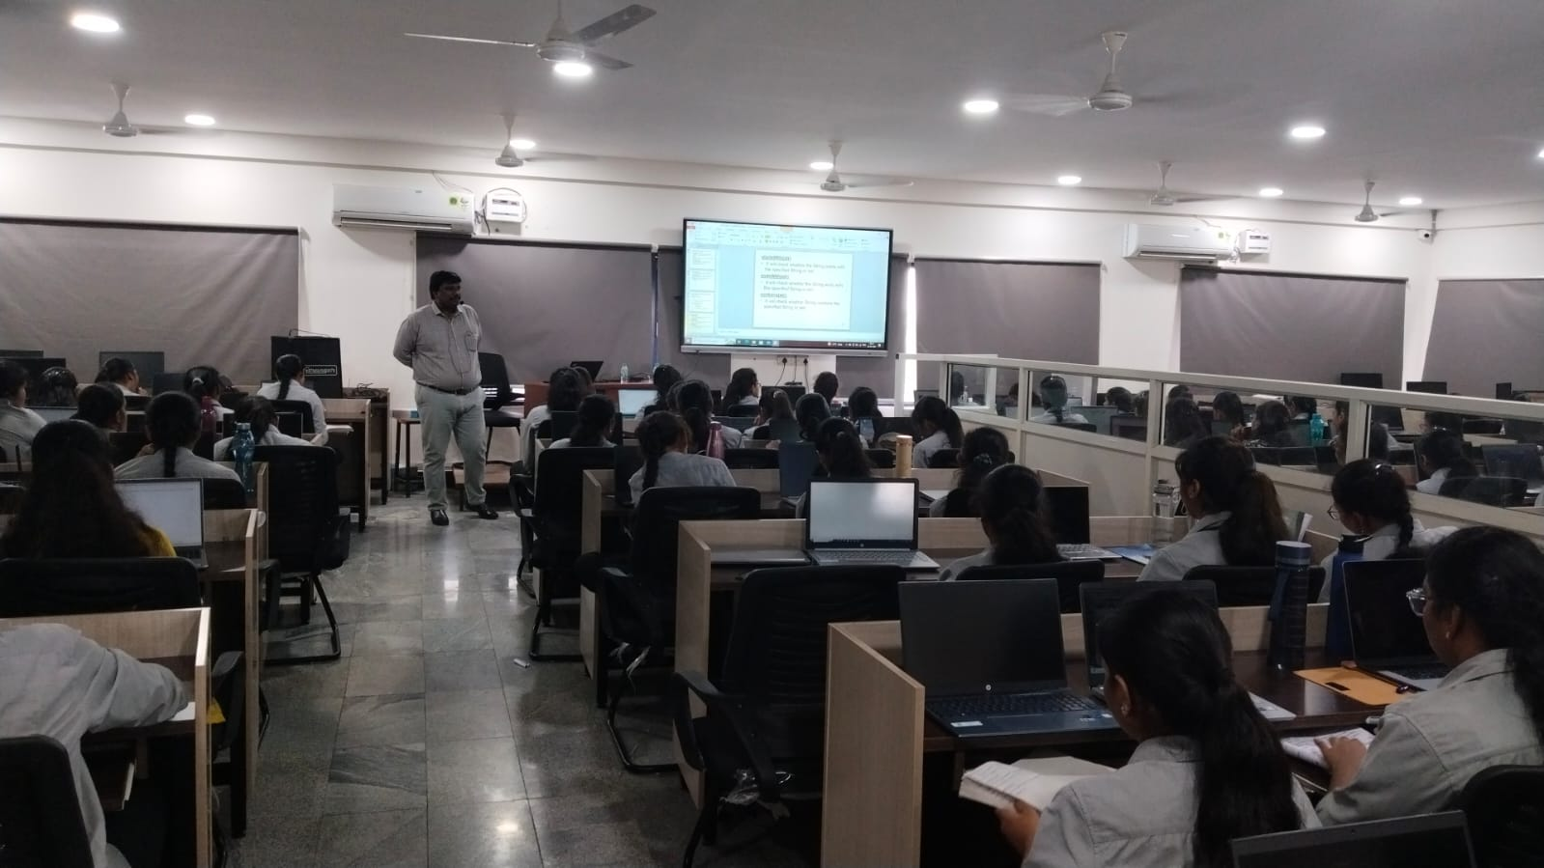

Slide 35
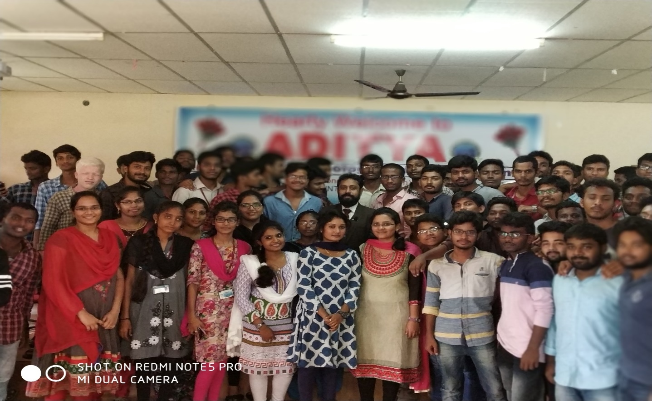

Slide 36
Thank You

